Slide 1

Point of expert
‘Our vision is to serve the best quality work’
Presented by:
Musab Siddiqui (20B-052-CS)
Ayesha Akhlaq (20B-015-CS)
Sidra Waseem (20B-89-CS)
Ahmed shakil (20B-106-CS)

Slide 2
INTRODUCTION
Specialization: Point of Expert focuses on digital embroidery and logo digitization services.
Logo Digitization: They specialize in precisely digitizing logos from different file formats, ensuring accuracy and quality.
Complex Design Conversion: Their services include converting intricate designs into embroidery-ready files, allowing for detailed and high-quality stitching.
Custom Embroidery: Point of Expert offers custom embroidery services for a range of items, including apparel, accessories, and promotional products.
Consultation and Design Support: They provide consultation and collaborative sessions to understand client needs, offering support in creating or refining logos for optimal digitization.

Slide 3
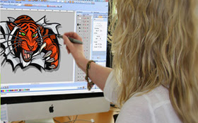
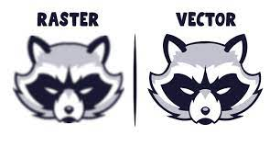
sERvices we provide
Embroidery digitizing
Raster to vector

Slide 4

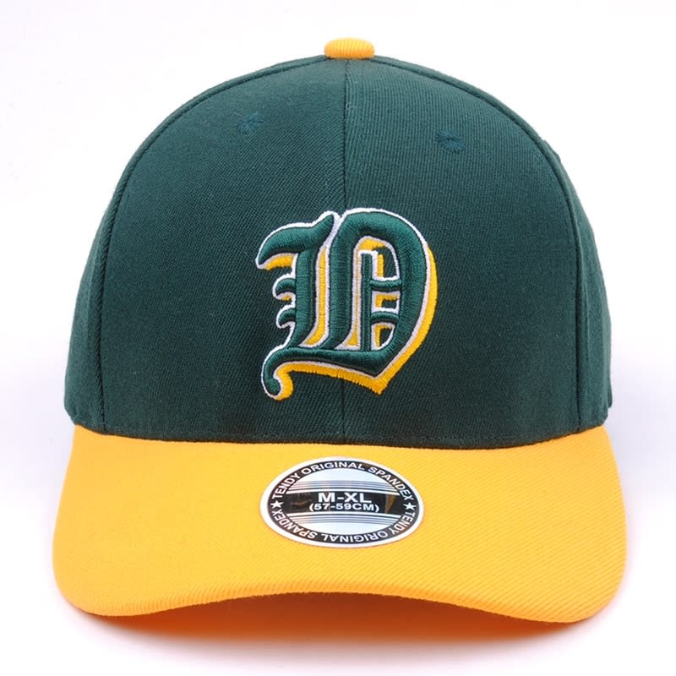
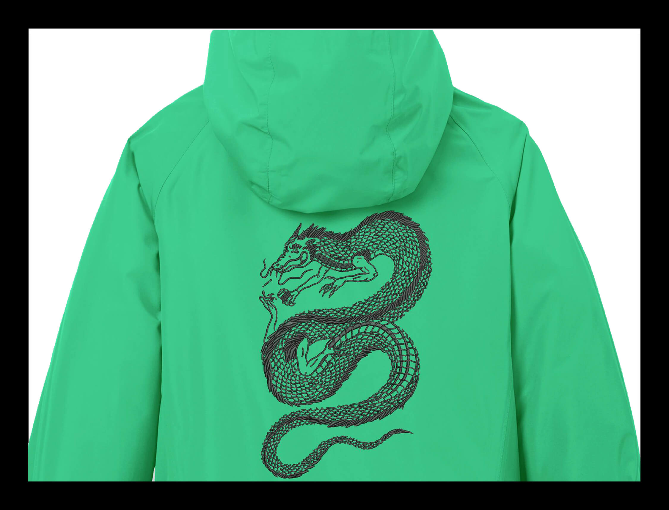
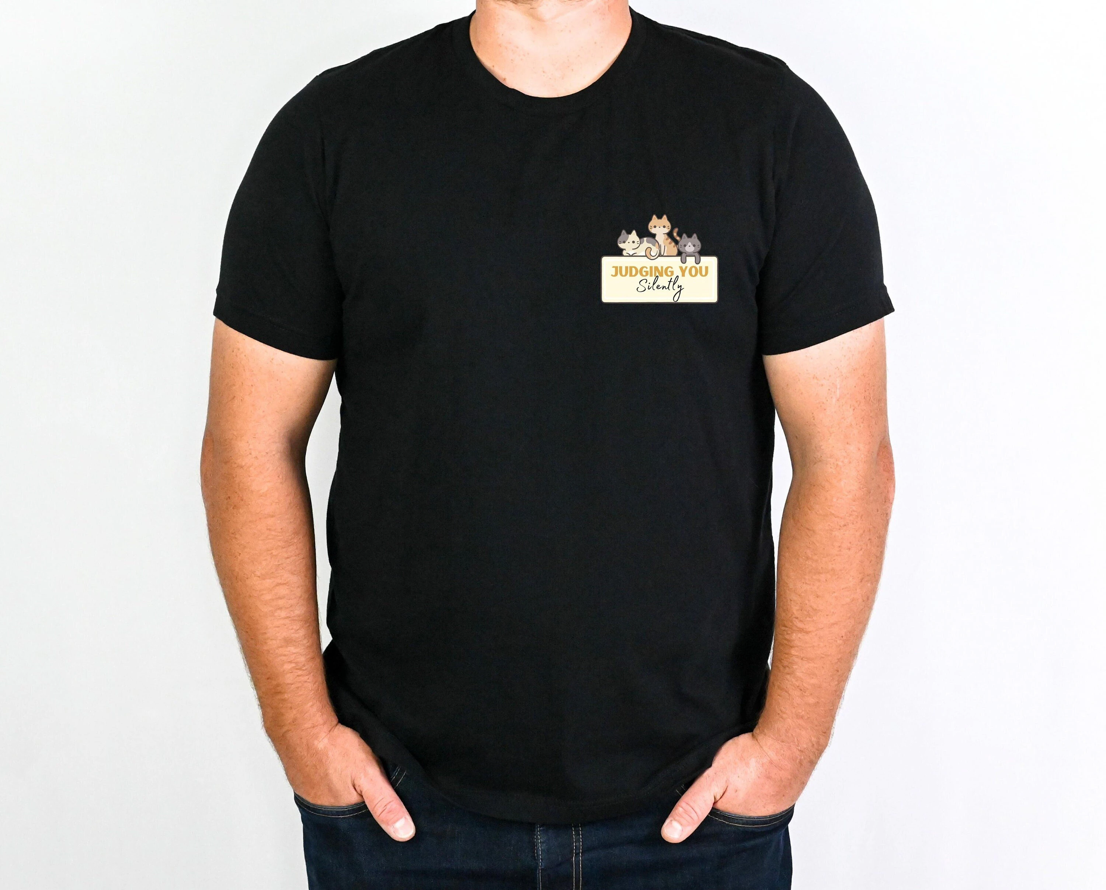
Embroidery digitizing
Embroidery digitizing is the process of converting your design into a digital format that the embroidery machine can comprehend.
This process allows for precise and detailed embroidery on various materials, such as clothing, hats, or other fabric items.

Slide 5
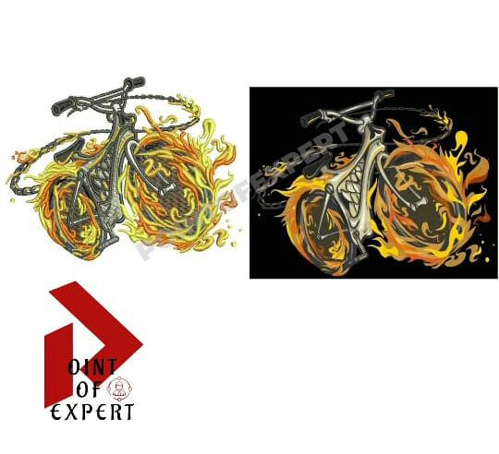

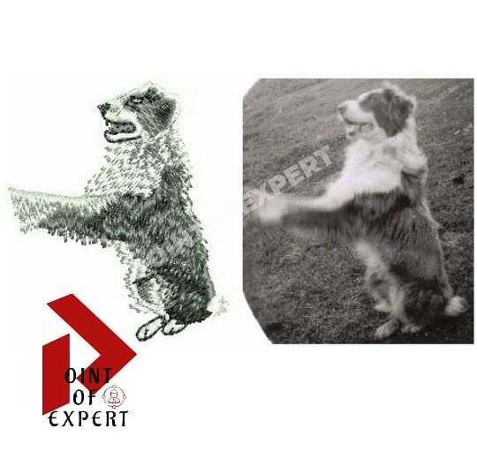
Our work

Slide 6
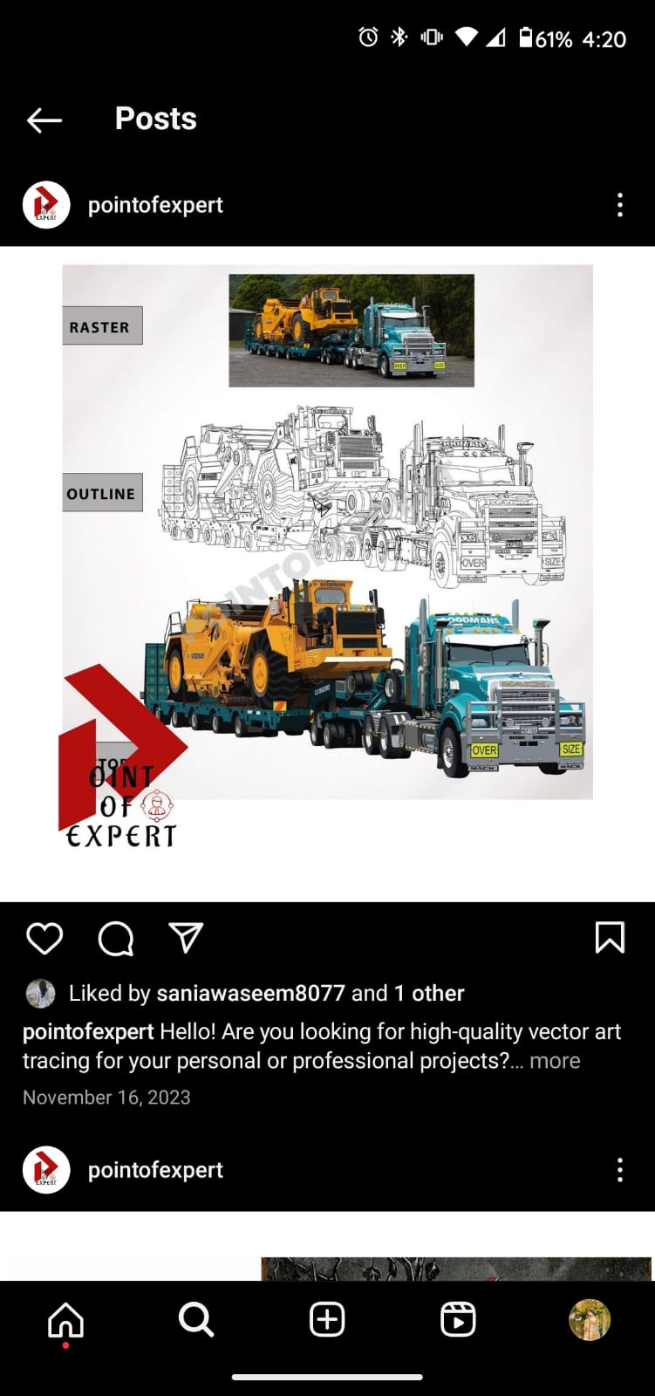
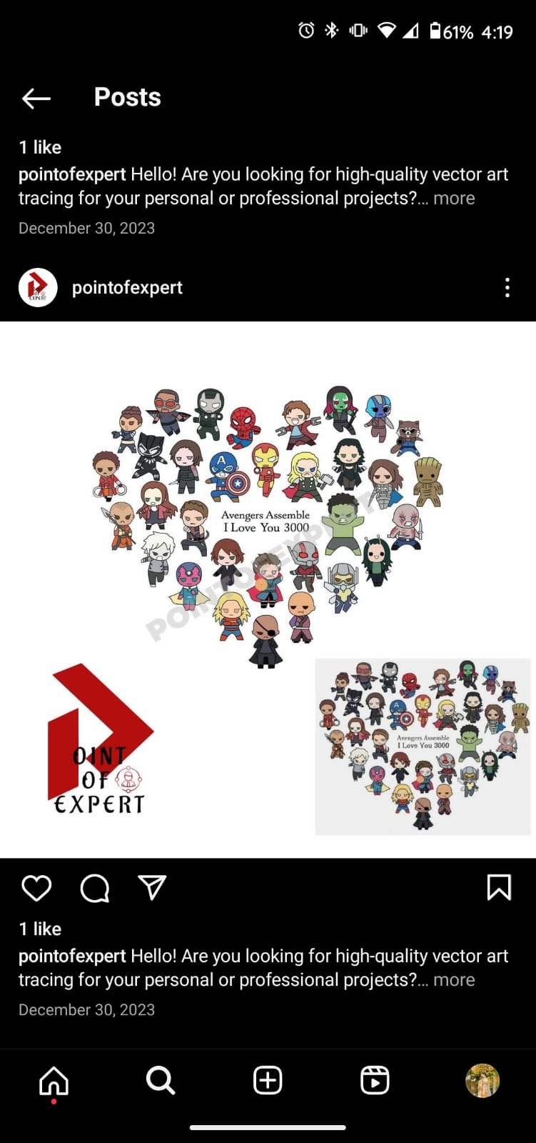

Raster to vector
Raster to vector conversion refers to transforming a design or artwork (which may be in a pixel-based format) into a clean and scalable vector format.

Slide 7
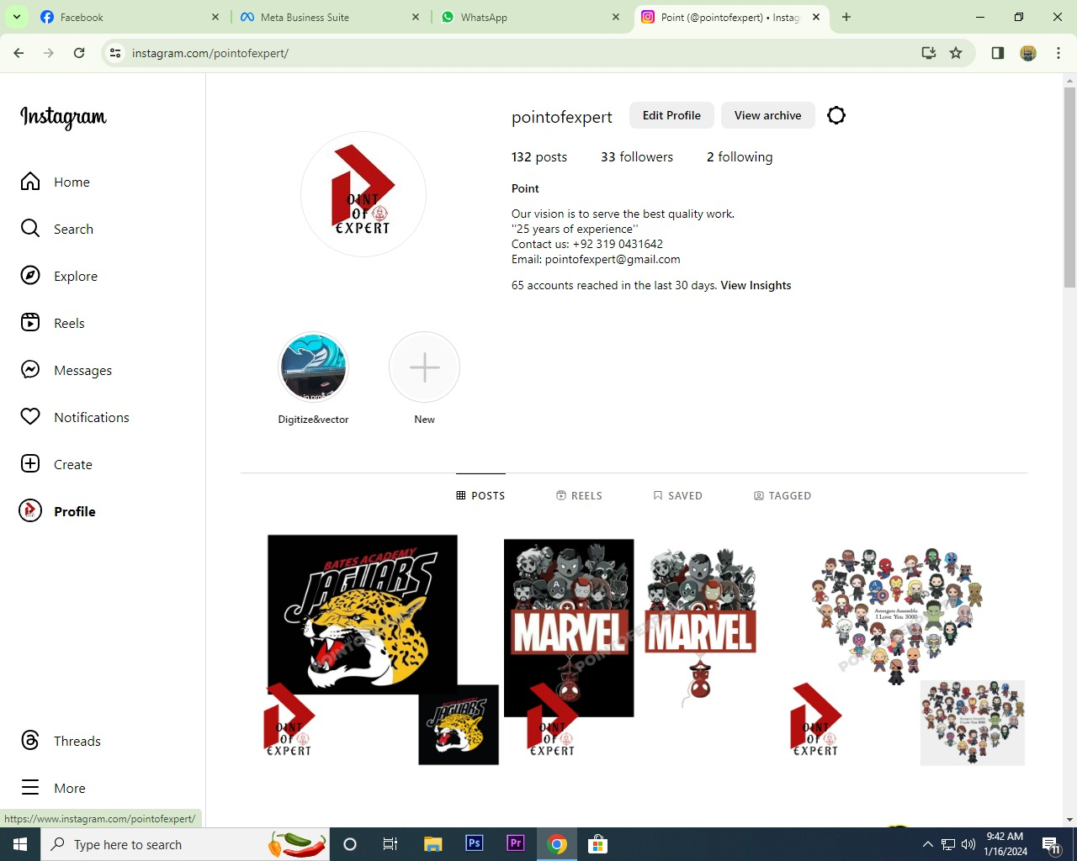
Our Instagram page
https://www.instagram.com/pointofexpert?igsh=M2U3ZnZzbGExaHc0

Slide 8
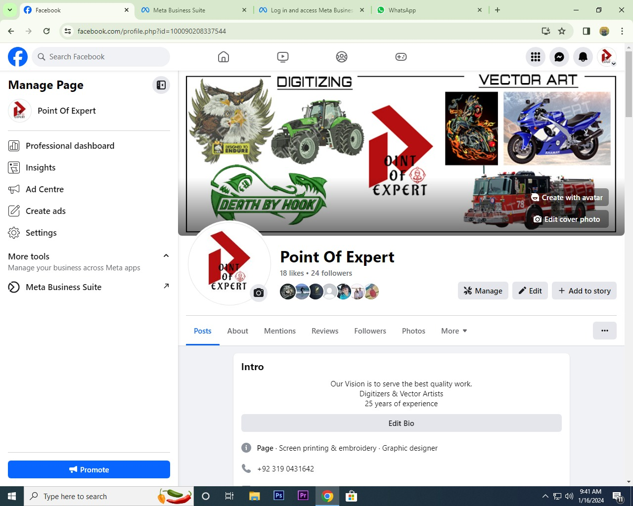
Our FACebook page
https://www.facebook.com/profile.php?id=100090208337544&mibextid=ZbWKwL

Slide 9
Thank you

